Slide 1


最近点对问题
2017303031 钟善扬

Slide 2
快排与归并直观比较
主定理法失效
6个点的优化
伪代码
Outline

Slide 3
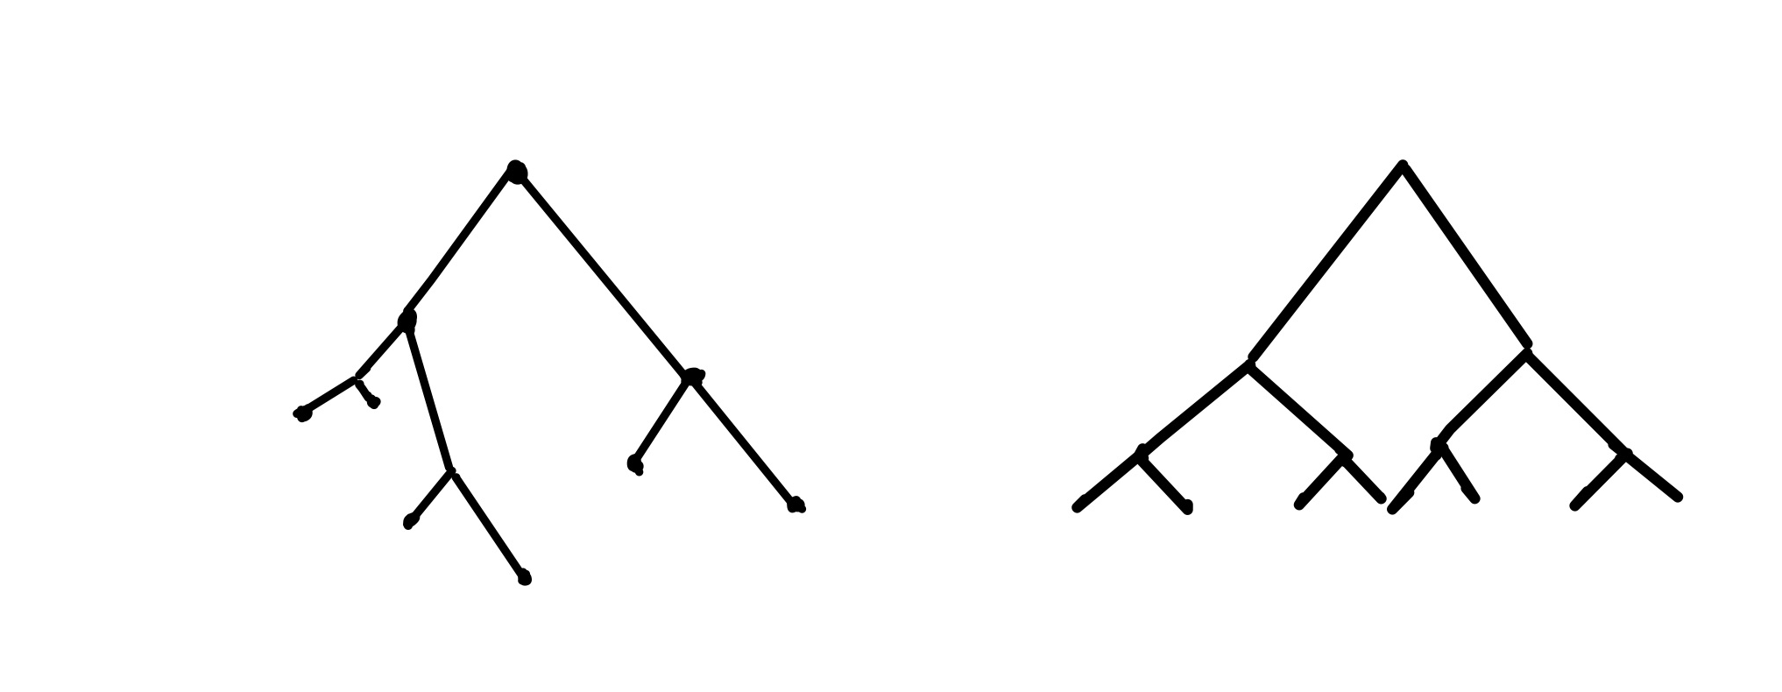
快排与归并直观比较
INNOVATION
BACKGROUND
IMPLEMENTATION
RESULTS & ANALYSIS
DISSCUSSION
CONCLUSION
Quick Sort
Merge Sort

Slide 4
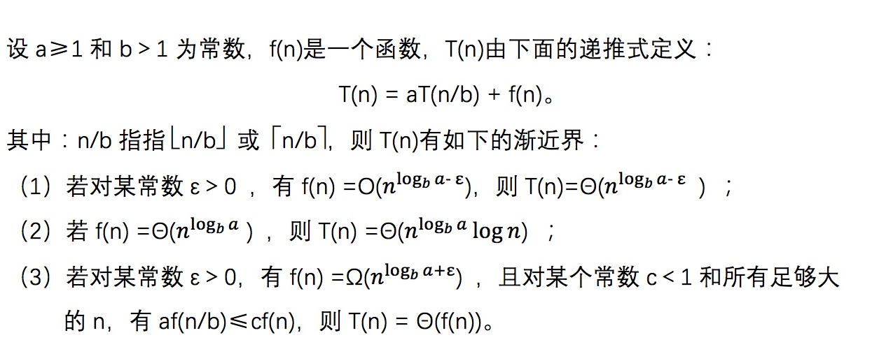
主定理法失效
INNOVATION
BACKGROUND
IMPLEMENTATION
RESULTS & ANALYSIS
DISSCUSSION
CONCLUSION

Slide 5
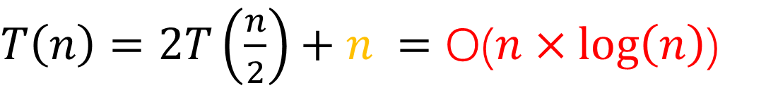

主定理法失效
INNOVATION
BACKGROUND
IMPLEMENTATION
RESULTS & ANALYSIS
DISSCUSSION
CONCLUSION
归并排序：
快速排序：
?

Slide 6
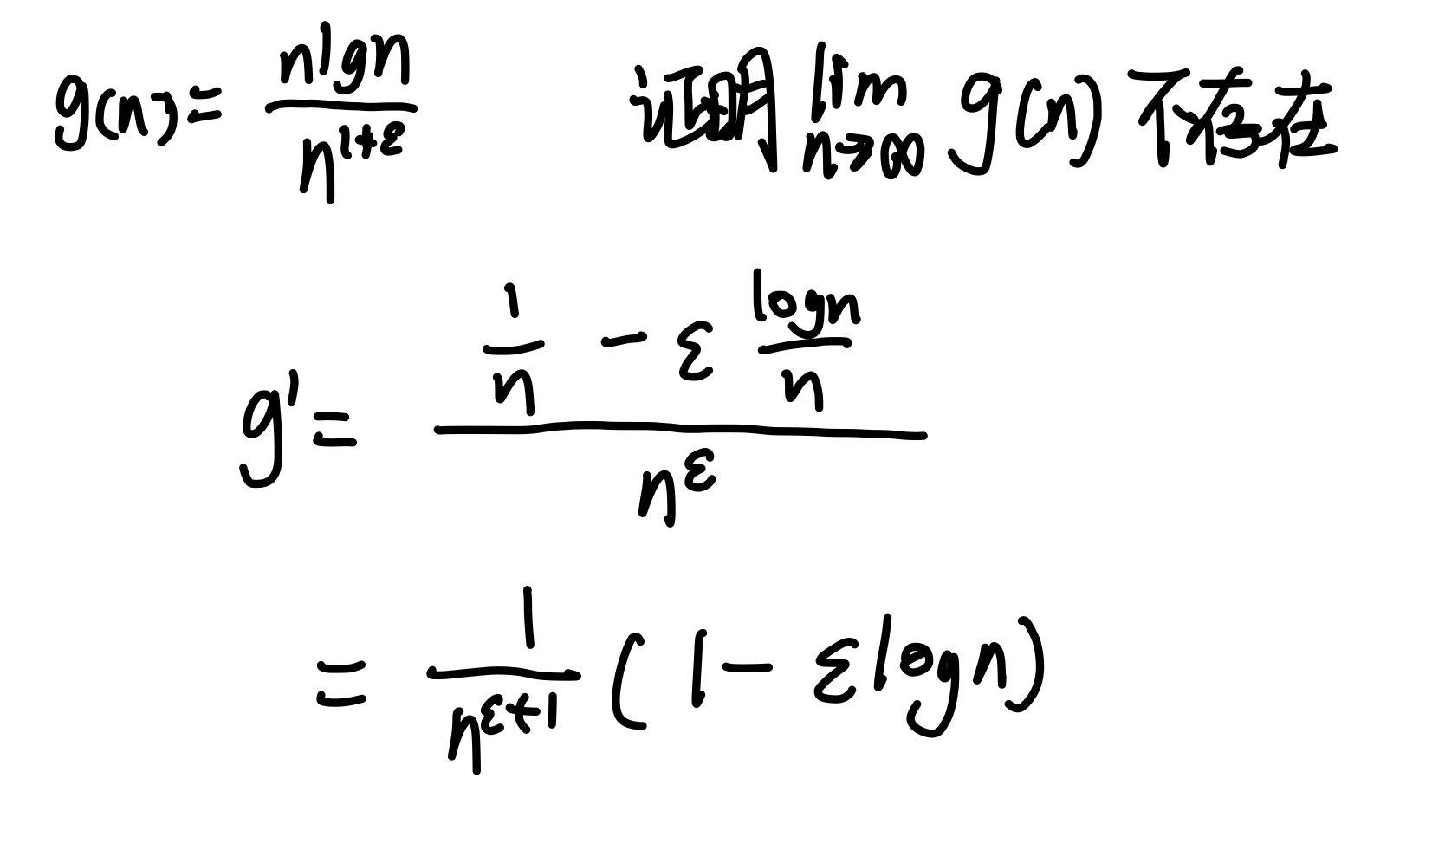
主定理法失效
INNOVATION
BACKGROUND
IMPLEMENTATION
RESULTS & ANALYSIS
DISSCUSSION
CONCLUSION

Slide 7












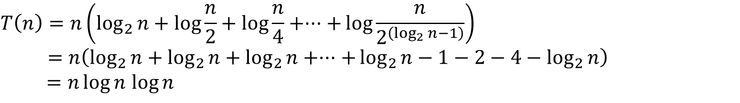
主定理法失效
INNOVATION
BACKGROUND
IMPLEMENTATION
RESULTS & ANALYSIS
DISSCUSSION
CONCLUSION

Slide 8
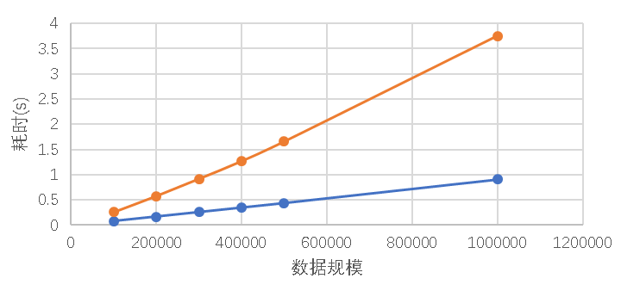
主定理法失效
INNOVATION
BACKGROUND
IMPLEMENTATION
RESULTS & ANALYSIS
DISSCUSSION
CONCLUSION

Slide 9
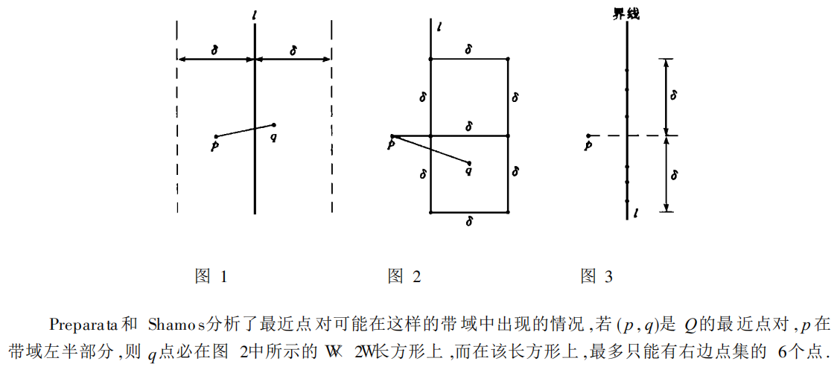
6个点的优化
INNOVATION
BACKGROUND
IMPLEMENTATION
RESULTS & ANALYSIS
DISSCUSSION
CONCLUSION

Slide 10
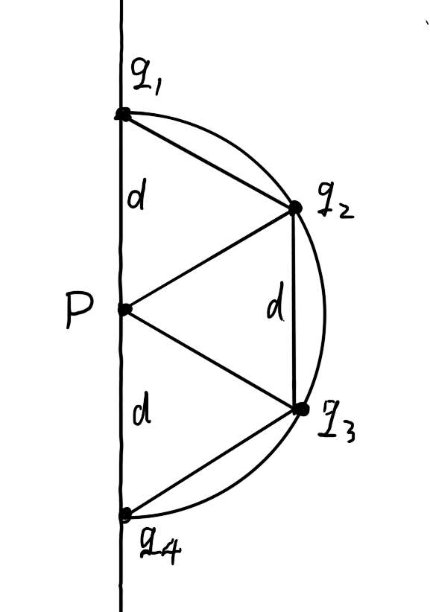
6个点的优化
INNOVATION
BACKGROUND
IMPLEMENTATION
RESULTS & ANALYSIS
DISSCUSSION
CONCLUSION

Slide 11
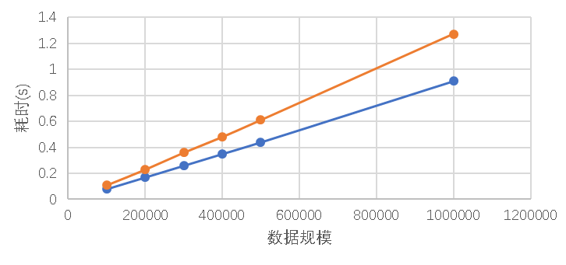
6个点的优化
INNOVATION
BACKGROUND
IMPLEMENTATION
RESULTS & ANALYSIS
DISSCUSSION
CONCLUSION

Slide 12
伪代码
INNOVATION
BACKGROUND
IMPLEMENTATION
RESULTS & ANALYSIS
DISSCUSSION
CONCLUSION
calClosest(int l,int r,point& a,point& b,double& m,point* p1,point* py,point* pz) //a，b保存最近点，m保存最近点距离 if r-l<=2 //若点集中只有2个或3个点，则直接计算 return closed; mid = (l+r)/2; //取点集下标中间值，该点就是在x方向分割点集的中间点 //py中保存着每个点在p1中的位置，根据保存的位置值进行分组，分成的两组对应p1的分组，在y方向上升序排序 sl = l,sr = mid+1; for i=l ~ r if(py[i].id>mid) pz[sr++] = py[i]; else pz[sl++] = py[i]; //计算分出来的两组的最近点距离并选出较小的值 calClosest(l,mid,a,b,m,p1,pz,py); calClosest(mid+1,r,aa,bb,mm,p1,pz,py); merge(py,pz,l,mid,r)//按照归并排序的合并操作将两个在y方向有顺序点集合并 k = l; for i=l ~ r //找出在x方向上距离中间点不超过m的点 if fabs(p1[mid].x-py[i].x)<m pz[k++] = py[i]; for i=l ~ k //在找出的点中对每个点找到y方向上离其不超过m的点并计算距离是否小于m for j=i+1 ~ i+4 && pz[j].y-pz[i].y<m double temp = dis(pz[i],pz[j]); if temp<m m = temp;

